Slide 1
Motor - Quote Details on Quote Page
Test Brief

Slide 2
Test Hypothesis
We know that a large portion of Motor users drop out on the quote page. We also know that many users just want to “get on with it”, find their price and pay. At the moment we don’t replay any important quote data until the 3rd step of the Agg journey. We believe that by displaying some key information to the customer on the quote page, we will reassure them that all the key info is correct. Also, by showing them a Quote ID, it will speed up any calls they make to the call centre. We believe this will have a positive impact on flow through to the next step of the journey.

Slide 3
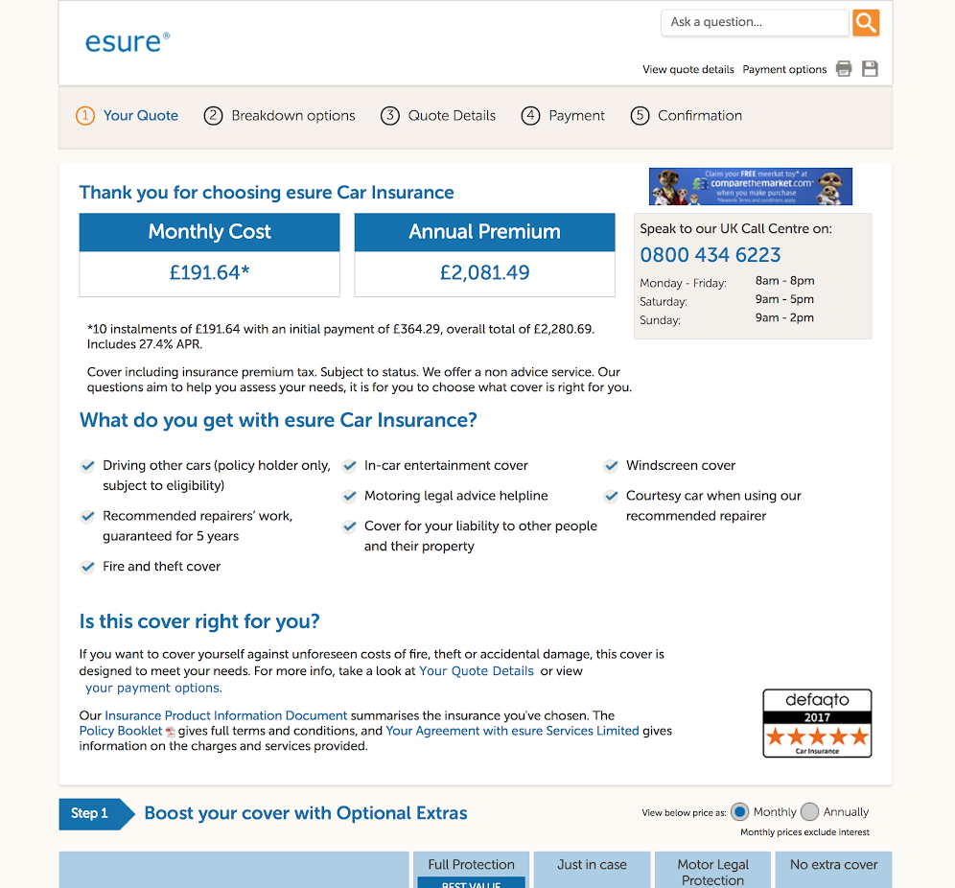
Original Motor Quote Page
New section will appear here, above the ‘What do you get…” section (see next slide)

Slide 4
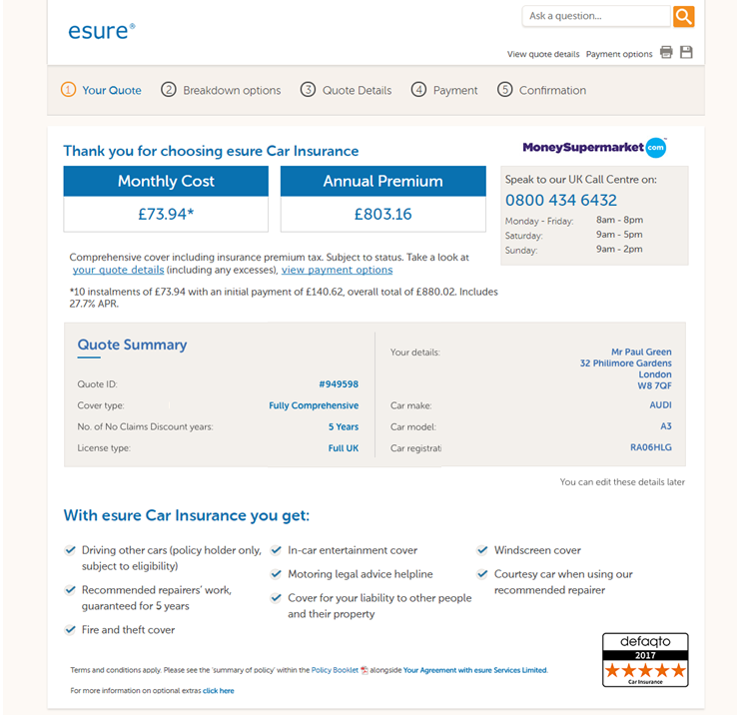
New Design
New Quote Summary Section
Note: This text is very important

Slide 5
Details
URL: /content/pages/product/motor/container/yourQuote.xhtml
Located: 1st step of the Agg journey
Main KPI: Visits to next step of journey

Slide 6
Data Layer
Variables Used
5
1
2
6
3
7
4
8
esureDataLayer.quoteID
esureDataLayer.motorCoverType
esureDataLayer.policyHolderMotorNCDYears
esureDataLayer.policyHolderLicenceType
esureDataLayer.policyHolderTitle .policyHolderFirstNames .policyHolderLastName esureDataLayer.policyHolderHouseNumber esureDataLayer.policyHolderHouseStreet esureDataLayer.policyHolderHousePostalTown esureDataLayer.policyHolderPostcode
esureDataLayer.carMake
esureDataLayer.carModel
esureDataLayer.carRegistration

Slide 7
Licence Type: Data Layer Values v.s. Customer Display Values
Licence Type Data Layer Values | Displayed to customer as:
UKA | Full UK (Automatics Only)
UK | Full UK
PUK | Provisional UK
EC | Full European
ECP | Provisional European
INT | Non UK/European
OTH | Other

Slide 8
Cover Type: Data Layer Values v.s. Customer Display Values
Cover Type Data Layer Values | Displayed to customer as:
COM | Fully Comprehensive
[If not COM] | Third Party, Fire and Theft

